Slide 1

GENERAL ELECTIONS
PYTHON PROJECT
By:
CHIRAG MAHAJAN
BHAVAY SHARMA
BHUVESH MITTAL
submitted to:
Gunjan thakur

Slide 2
PROJECT MEMBERS
BHUVESH MITTAL
BHAVAY SHARMA
CHIRAG MAHAJAN
Logic builder
Coder
Graphics editor
Testing manager
Graphics editor
Presenter
Analyst
PPT designer
Graphics editor

Slide 3

Why do we need elections?
Finding out if the people like their representatives or not requires a mechanism by which people can choose their representatives and change them at different intervals. That is why elections are essential.

Slide 4
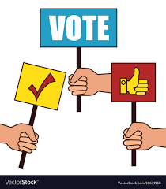
INTRODUCTION
Electronic voting(also known as e-voting) is voting using electronic system to aid casting and counting votes.
E-voting is an electronic system that allows a voter to record his or her secure and secret ballot electronically.
E-voting or electronic voting is a broader sense of use of electronic means in one of the following three processes:
Identification of voters
Casting the vote
Counting the vote

Slide 5
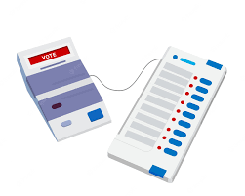
0NLINE VOTING SYSTEM contains:
1. Voter’s information in database
2. Voter’s id
3. Voter’s vote in database
4. Calculation of total number of votes.
5. Finish of elections.

Slide 6
WORKING APPROACH
Voters will get a choice to choose from four candidates to whom they want to elect.
Asks the user to input his voter id.
Duplicate id’s not allowed.
Only high authority members can see results and finish the elections .
The result will be shown graphically at the end.

Slide 7
Advantages of this project: 1. This project will be very useful to conduct the elections to appoint the CR/HR. 2. It may also help to get the opinions of students in the university events. 3. This project will help to conduct the general body elections.

Slide 8
FUTURE SCOPE OF THE PROJECT
The voting system can be connected to a network so that everyone can vote from their respective pc’s.
The voting system will be available in metaverse(virtual reality).
Candidate’s name and symbol will pop out in graphical window.

Slide 9
THANK YOU

